Slide 1

Welcome
Logipool Infotech Pvt. Ltd

Slide 2
Function
A function is a sub-part of a program that contains a collection of statements grouped together to perform some specific task.
Syntax:
dataType functionName (Parameter List)

Slide 3
Two types of function in C
Standard library functions
User defined functions

Slide 4
Standard library functions
standard library functions are built-in functions in C programming to handle tasks such as mathematical computations, I/O processing, string handling etc.
The printf() is a standard library function to send formatted output to the screen (display output on the screen). This function is defined in "stdio.h" header file.

Slide 5
User-defined function
C allow programmers to define functions. Such functions created by the user are called user-defined functions.
Function Prototype (function declaration)
Function Definition
Function Call

Slide 6
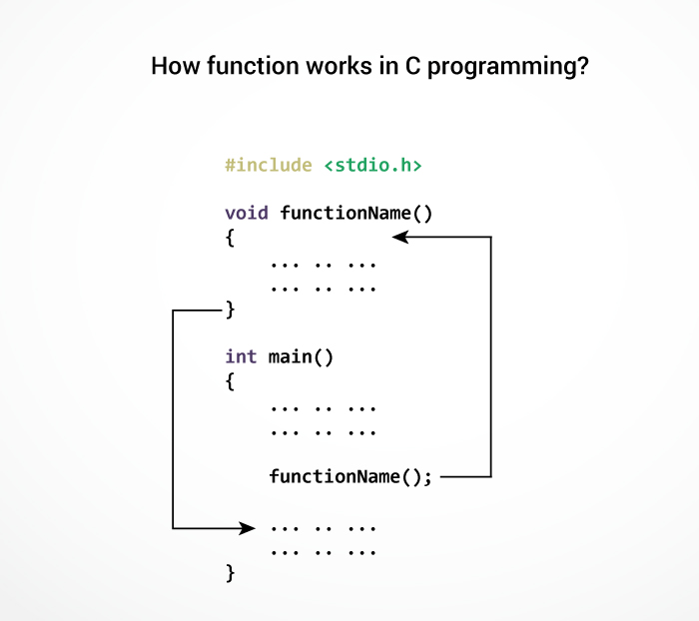

Slide 7
Function Prototype
Syntax:
dataType functionName (Parameter List);
Example:
int addition();

Slide 8
Function Defination
returnType functionName(Function arguments)
{
//body of the function
}
Example:
int addition()
{
}

Slide 9
Types of function
Based on prototype, user defined function are further categorized in four categories.
Function with no return and no argument
Function with no return but arguments
Function with return but no argument
Function with return and arguments

Slide 10
Syntax to define function with no return no argument
void function_name()
{
// Function body
}

Slide 11
Syntax to define function with no return but with arguments
void function_name(type arg1, type arg2, ...)
{
// Function body
}

Slide 12
Syntax to define function with return but no arguments
return_type function_name()
{
// Function body return some_value;
}

Slide 13
Syntax to define function with return and arguments
return_type function_name(type arg1, type arg2, ...)
{
// Function body return some_variable;
}

Slide 14
Recursion in C programming
Recursion is expressing an entity in terms of itself.
In C programming, recursion is achieved using functions known as recursive function.

Slide 15
void recursive_function()
{
// Some codes
recursive_function();
// Unreachable code
}
int main()
{
recursive_function();
}

Slide 16
Thank You

